Slide 1

COMP 499/691: Conversational Artificial Intelligence
Automatic Speech Recognition (ASR)
Computer Science & Software Engineering
Concordia University, Winter 2024

Slide 2
Summary of the last episode….
What we have seen last time:
Self-Supervised Speech Features
What we are going to learn today:
Automatic Speech Recognition (ASR)

Slide 3
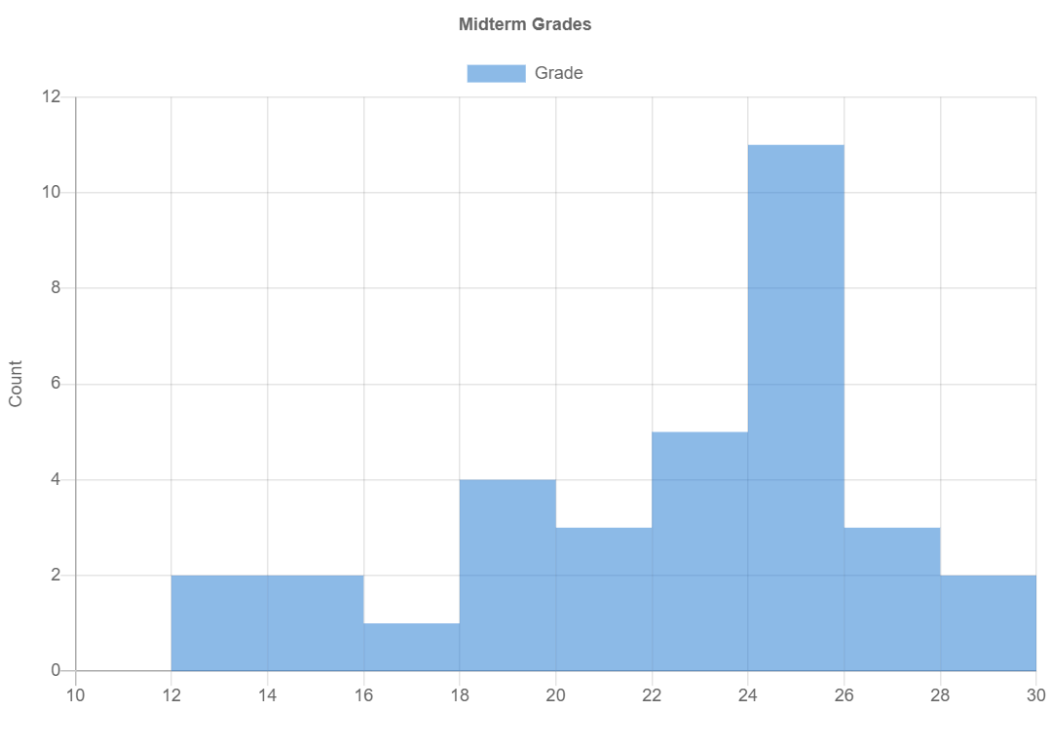
Summary of the last episode….
Average = 22.2

Slide 4
Historical Notes

Slide 5
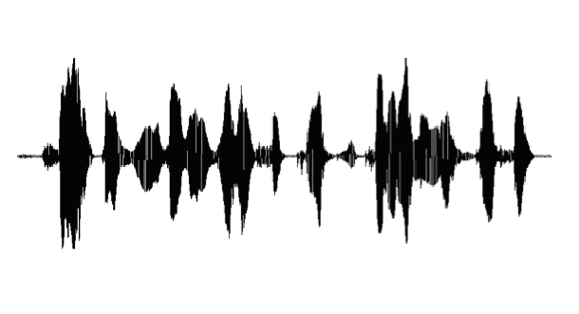
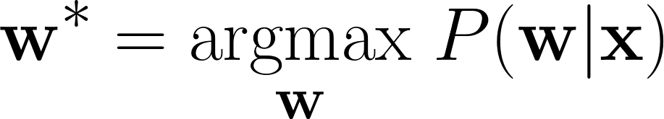
Historical Notes
Automatic Speech Recognition (ASR)
Speech
Recognizer
Text
w = [w1, …, wN ]
x
Goal: convert a speech signal into the sequence of words uttered by the speaker.

Slide 6
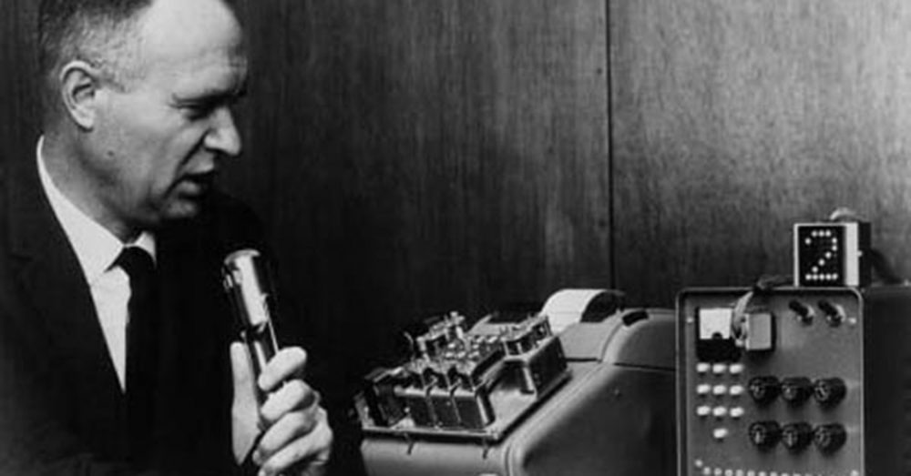
Historical Notes
Speech Recognition has a long history:
The first speech recognizer was developed in 1952 at Bell Laboratories.
1950
Rule-based methods
1960
AUDREY could recognize digits (zero to nine) with 90% accuracy (but only if spoken by its inventor)
Template Matching
1980
Hidden Markov Models (HMMs)
2012
HMMs + Deep Neural Networks
2018
End-to-end ASR

Slide 7
Historical Notes
Speech Recognition has a long history:
1950
The first attempts in the 50s and 60s were rule-based.
Rule-based methods
1960
These systems compute some basic features and apply some simple rules on top of it:
Template Matching
1980
Rule examples:
Hidden Markov Models (HMMs)
If 693 Hz < Formant1 < 988 Hz and
1188 Hz < Formant2 < 1648 Hz then
Phoneme = “a”
2012
HMMs + Deep Neural Networks
If 452 Hz < Formant1 < 769 Hz and
1741 Hz < Formant2 < 2362 Hz then
Phoneme = “e”
2018
End-to-end ASR
……

Slide 8
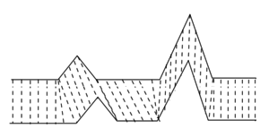
Historical Notes
Speech Recognition has a long history:
1950
Rule-based systems do not generalize well.
Rule-based methods
1960
In the late 60s and 70s researchers studied template-matching approaches.
Template Matching
1980
In particular, dynamic time warping was used.
Hidden Markov Models (HMMs)
Dynamic time warping is a technique to measure the similarity between two sequences (that might have different lengths).
2012
HMMs + Deep Neural Networks
2018
End-to-end ASR

Slide 9
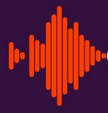

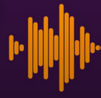

Historical Notes
Speech Recognition has a long history:
1950
The training set is composed of isolated words.
Rule-based methods
Word 1
1960
Template Matching
Word 2
At inference time, we take the label corresponding to the most similar signal.
1980
Word 3
Hidden Markov Models (HMMs)
2012
Test signal
Similarity 0.5
HMMs + Deep Neural Networks
2018
Similarity 0.3
End-to-end ASR
Similarity 0.8
Word 3

Slide 10

Historical Notes
Speech Recognition has a long history:
1950
These systems worked reasonably well at isolated word recognition.
Rule-based methods
1960
They cannot be used for continuous speech recognition.
Template Matching
1980
Hidden Markov Models (HMMs)
An example is the Hearsay system by Carnegie Mellon University (CMU).
2012
HMMs + Deep Neural Networks
https://www.youtube.com/watch?v=kJ9WekPYaXQ
2018
End-to-end ASR

Slide 11
Historical Notes
Speech Recognition has a long history:
1950
During the 80s, there was a progressive decline of pattern-matching methods in favor of statistical approaches.
Rule-based methods
1960
Template Matching
Hidden Markov Models (HMMs) emerged as the dominant paradigm for statistical ASR.
1980
Hidden Markov Models (HMMs)
Advantages:
Efficient training and inference algorithms.
Flexibility in merging acoustic, lexicon, and language information.
Ability to work with continuous words.
2012
HMMs + Deep Neural Networks
2018
HMMs were dominant until attention-based neural networks emerged.
End-to-end ASR

Slide 12
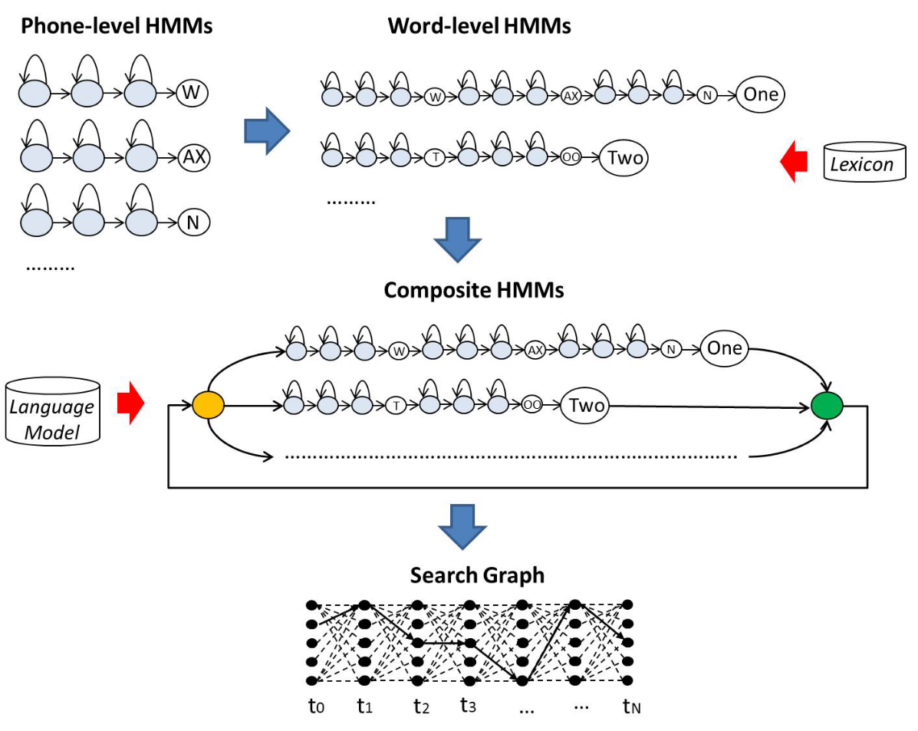
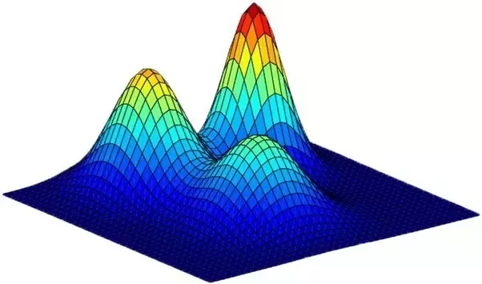
Historical Notes
Speech Recognition has a long history:
1950
Rule-based methods
1960
Template Matching
1980
Hidden Markov Models (HMMs)
2012
HMMs + Deep Neural Networks
Every state is modeled by a Gaussian Mixture Model (GMM)
2018
End-to-end ASR

Slide 13
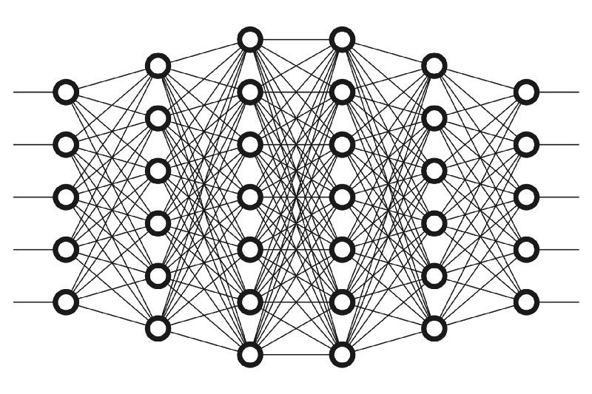
Historical Notes
Speech Recognition has a long history:
1950
In standard HMMs, each state is modeled by a GMM:
Rule-based methods
1960
Template Matching
1980
Hidden Markov Models (HMMs)
Around 2012, DNN started to become very popular.
The community quickly switched to HMM-DNN systems:
2012
HMMs + Deep Neural Networks
Advantages:
2018
Larger Capacity
Hierarchical Representations
Better Performance
End-to-end ASR

Slide 14
Historical Notes
Speech Recognition has a long history:
1950
Around 2018, attention-based models quickly replaced HMMs.
Rule-based methods
1960
This is called end-to-end speech recognition (E2E-ASR)
Template Matching
1980
E2E ASR is the state-of-the art technology.
Hidden Markov Models (HMMs)
Advantages:
2012
No need to precompute alignments
Simpler pipeline
Better Performance
HMMs + Deep Neural Networks
2018
End-to-end ASR

Slide 15

Historical Notes
Speech Recognition has a long history:
Search
Do you notice some trends?
1950
Rule-based methods
1960
Trends
Template Matching
Learn as much as you can!
Replace “brute-force” search with learning.
With learning, we can generalize better!
Train big models with huge datasets.
1980
Hidden Markov Models (HMMs)
2012
HMMs + Deep Neural Networks
2018
End-to-end ASR
Learning

Slide 16
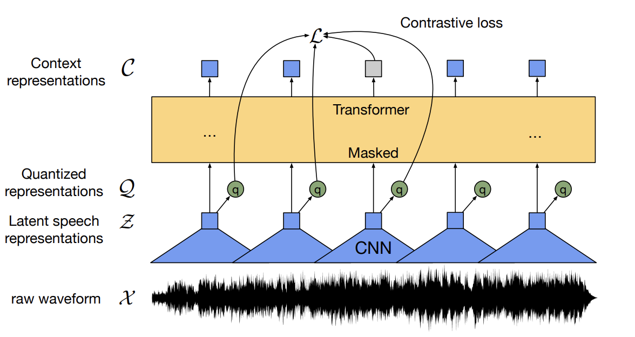
Recent Trends
What are the most recent trends?
2018
Models like Wav2vect2, Hubert, and WavLM, have been proposed and widely used as feature extractors for ASR models.
End-to-End ASR
2019
Self-supervised Learning
2021
Massive Multilingual ASR
2023
Multitask Learning
2024
Multimodal Learning

Slide 17
Recent Trends
What are the most recent trends?
2018
Massive Multilingual ASR: Utilizing a single neural network for multiple languages (e.g., 50, 100).
End-to-End ASR
2019
Self-supervised Learning
Lang1
2021
ASR
Lang2
Massive Multilingual ASR
…
2023
Lang3
Multitask Learning
2024
It turned out that the performance of massive multilingual ASR outperforms single-language ASR.
Multimodal Learning

Slide 18
Recent Trends
What are the most recent trends?
2018
Systems that jointly solve multiple speech-processing tasks as quickly emerging.
End-to-End ASR
2019
Self-supervised Learning
ASR
2021
DNN
Speech Translation
Massive Multilingual ASR
…
2023
Voice Activity Detection
Multitask Learning
2024
A notable example is Whisper, developed by OpenAI
Multimodal Learning

Slide 19

Recent Trends
What are the most recent trends?
The ongoing trend is to build intelligent machines (e.g., Large Language Models) that integrate different modalities (e.g., Text, Audio, Video).
2018
End-to-End ASR
2019
Self-supervised Learning
The discrete audio representations mentioned in the previous lecture are bridging the gap between audio and NLP.
2021
Massive Multilingual ASR
Examples of multimodal systems are the latest LLM (e.g. Gemini)
2023
Multitask Learning
2024
Multimodal Learning

Slide 20
Overview of a Modern ASR

Slide 21
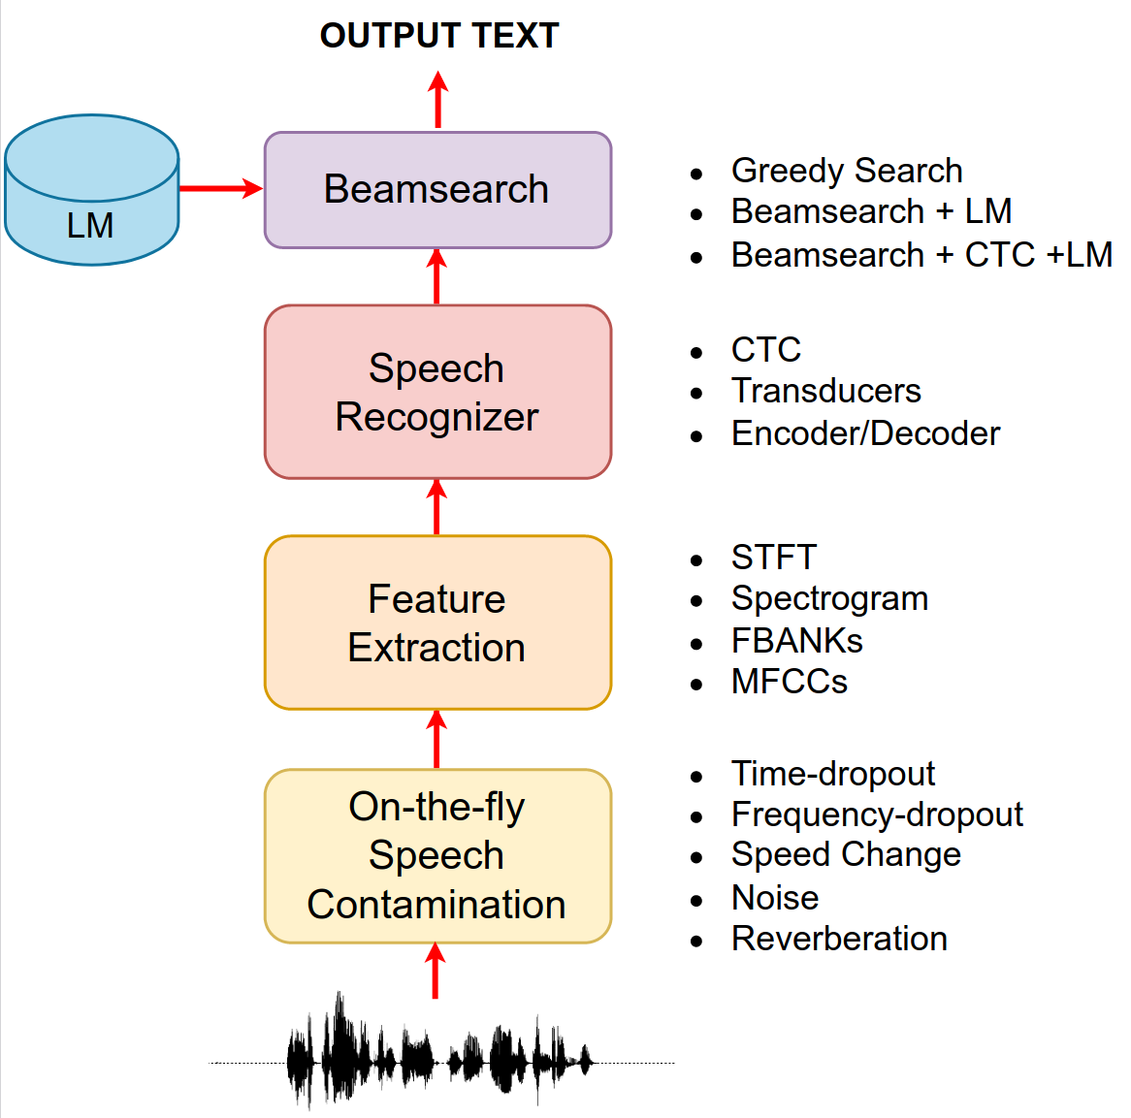
Overview of a Modern ASR
Data Contamination
The signal might be contaminated using various techniques such as:
time/frequency dropout
speed change
adding noise and reverberation.
Contamination is performed at training time only.
It can be applied on-the-fly, resulting in each sentence being modified in a unique way at every epoch.

Slide 22
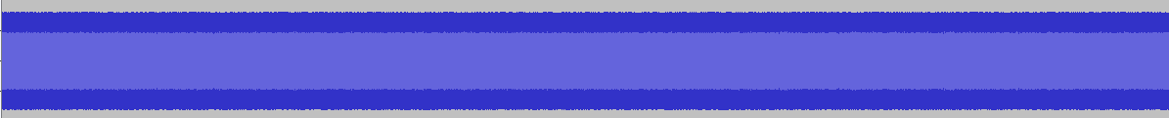
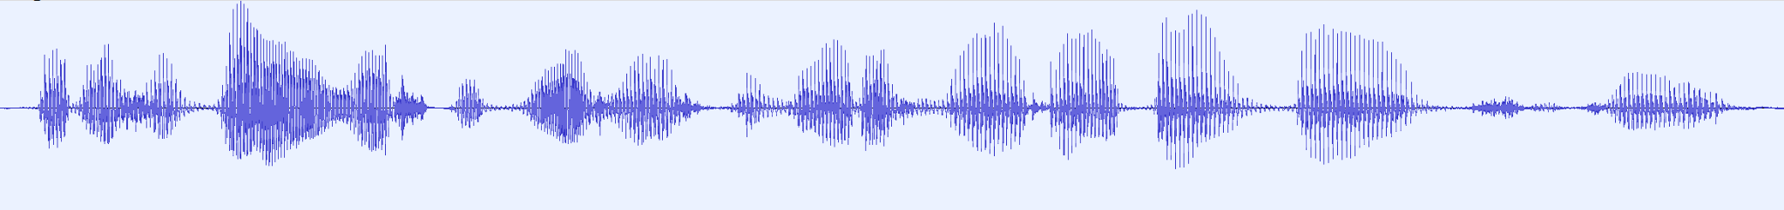
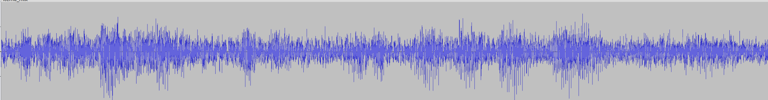
Overview of a Modern ASR
Adding Noise
Noise Dataset
Sample
Clean Sentence
Sample an SNR
Contaminated Signal

Slide 23
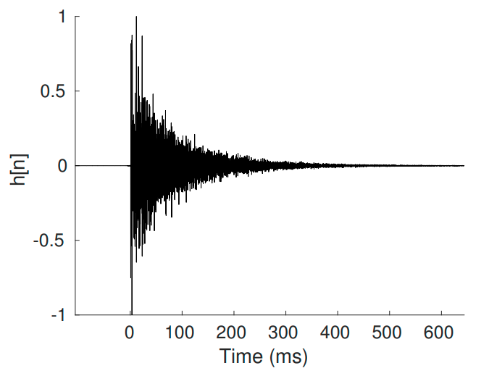
Overview of a Modern ASR
Adding Reverberation
IR Dataset
Sample
Clean Sentence
Convolution
Contaminated Signal

Slide 24

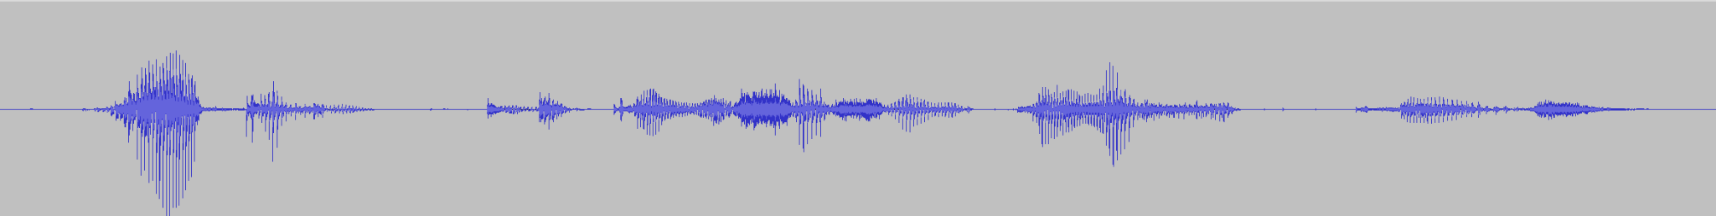
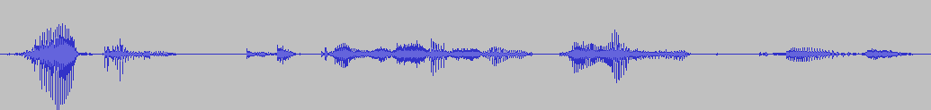
Overview of a Modern ASR
Speed Change
Speed change is implemented by slightly changing the sampling frequency of the signal.
This has the effect of changing the speech rate as well as pitch and formants.
Original
10% Slower
10% Faster

Slide 25
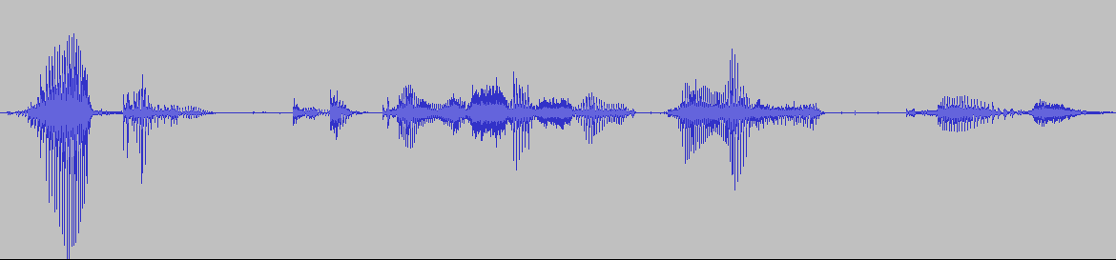
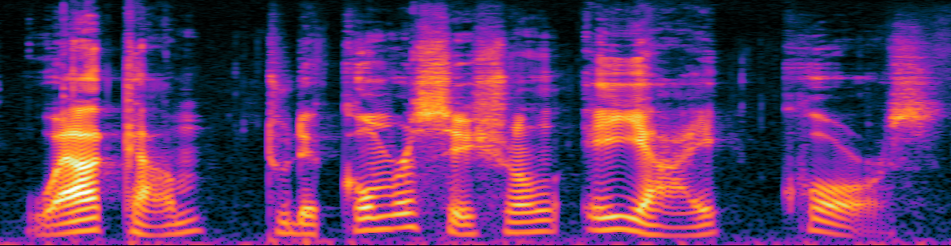
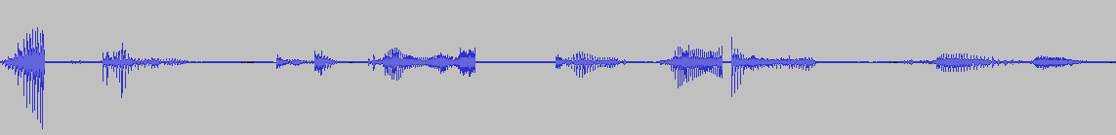
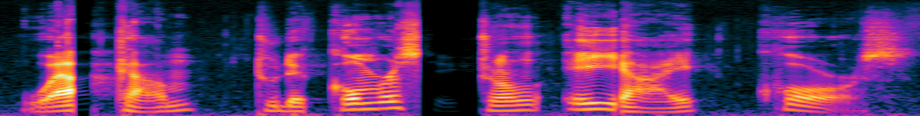
Overview of a Modern ASR
Time Dropout
Time Dropout consists of adding random chunks of zeros into the signal.
Original Signal
Contaminated Signal

Slide 26
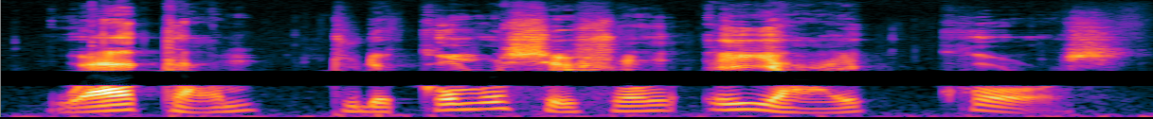
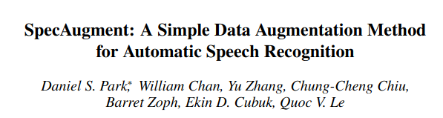
Overview of a Modern ASR
Frequency Dropout
Frequency Dropout consists of randomly zeroing out some frequency bands.
Original Signal
Contaminated Signal
Paper

Slide 27
Overview of a Modern ASR
After data augmentation, there might be a feature extraction step.
Typically, we use 40 FBANKs.
As an alternative, we can use MFCCs, Spectrogram, or the STFT.
In some cases, we do not need a feature extraction step.
As we have seen, we can feed raw samples as well in neural networks (e.g, as done in SincNet or self-supervised models).

Slide 28
Overview of a Modern ASR
We then have a speech recognition neural network.
Encoder-Decoder Architectures
RNN-based
Transformer-based
Connectionist Temporal Classification (CTC)
Standard CTC
Transducers

Slide 29
Overview of a Modern ASR
Beamsearch
Beamsearch is a search algorithm used to find the most likely sequence of words.
We explore step-by-step different alternatives and keep the most promising ones.
The "beam" refers to the number of alternatives that the algorithm considers at each step.
The alternatives can be optionally rescored with an external language model.
Beam search is an algorithm used in speech recognition to find the most likely sequence of words that a speaker intended to say. It works by exploring multiple possible paths through the language model, keeping only the most likely paths based on the probability of each word given the previous words.. By limiting the number of paths, the algorithm can efficiently search through the possibilities and find the most likely transcription.

Slide 30
Tokenization

Slide 31
Tokenization
The first design decision for a speech recognizer is choosing which tokens to use for the output prediction.
There are different options:
Do we predict words?
Do we predict characters?
Do we predict phonemes?
Do we predict something else?

Slide 32
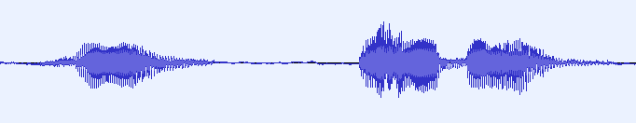


Tokenization
One option is to use full words as basic tokens.
THE
CITY
OF
w1
w2
wL
w1
w2
wL
w1
w2
wL
…….
…….
…….
Encoder
Decoder
Decoder
Decoder
Decoding step=0
Decoding step=1
Decoding step=2
At each decoding step, we have a softmax over the set of possible words.
The output sequences will be short (compare to characters)
The system cannot generalize to new words
Large output space
Rare words might have few training examples

Slide 33
Tokenization
One other option is to use characters as basic tokens.
T
H
E
c1
c2
cL
c1
c2
cL
c1
c2
cL
…….
…….
…….
Encoder
Decoder
Decoder
Decoder
Decoding step=0
Decoding step=1
Decoding step=2
At each decoding step, we have a softmax over the set of possible characters.
Small output space (we might have 20-30 chars)
The number of characters within a sentence is quite large.
Long sequences are critical (i.e., more memory, more computation, harder to converge).
The system can generalize to new words
Enough training material for each character

Slide 34
Tokenization
One other option is to use phonemes as basic tokens.
/DH/
/AH/
/S/
c1
c2
cL
c1
c2
cL
c1
c2
cL
…….
…….
…….
Encoder
Decoder
Decoder
Decoder
Decoding step=0
Decoding step=1
Decoding step=2
At each decoding step, we have a softmax over the set of possible phonemes.
Phonemes are natural speech targets as they represent basic sounds.
We require phoneme annotation for each word.
Converting words to phonemes in some languages (e.g., English) is challenging.
The system can generalize to new words
Enough training material for each phoneme.

Slide 35
Tokenization
What about using something in between words and characters?
The basic idea is to allocate tokens for the most frequent sequences of characters.
For instance:
“THE CITY OF MONTREAL” => ['THE', '▁CITY', '▁OF', '▁MO', 'NT', 'RE', 'AL']`
The article 'THE' and the preposition 'OF' are very common and we can allocate full tokens for them.
Instead, we might wanna split "MONTREAL" into smaller pieces that are observed more frequently than the full word.

Slide 36
Tokenization
A common tokenization algorithm is Byte Pair Encoding (BPE):
The BPE algorithm works as follows:
Count the frequency of each consecutive pair of characters in the training corpus.
Find the most frequent pair.
Merge the two characters in the pair into a new token.
Repeat steps 1-3 until the desired number of tokens is reached.
Iteration 1
"aaabdaaabac"
Iteration 2
"ZabdZabac"
Iteration 3
"ZYdZYac"
Final string: “XdXac”
aa: 4
ab: 2
bd: 1
da: 1
ba: 1
ac: 1
Z
Za: 2
ab: 2
bd: 1
dZ: 1
ba: 1
ac: 1
ZY: 2
Yd: 1
dZ: 1
Ya: 1
ac: 1
X
Allocated Tokens:
0 - “aaab”
1 - “d”
2- “a”
3 -”c”
Y

Slide 37

Tokenization
BPE are largely used in speech recognition and natural language processing.
BPE (and other tokenization algorithms) are implemented here:
SentencePiece
https://github.com/google/sentencepiece
Recent speech recognition trend: use characters as basic units instead of tokens.
Benefits include a cleaner pipeline and better generalization to new words.
Characters are more computationally demanding and harder to train (due to due to longer output sequences). However, using large self-supervised models help make training easier and achieve excellent performance.

Slide 38
Speech Recognizer

Slide 39
Speech Recognizer
Many neural networks can be used for speech recognition.
Encoder-Decoder Architectures
RNN-based
Transformer-based
Connectionist Temporal Classification (CTC)
Standard CTC
Transducers

Slide 40
Encoder-Decoder ASR

Slide 41
Encoder-Decoder ASR
We already have seen Encoder-Decoder architectures for seq2seq learning.
In ASR, the input is a sequence of speech features, and the output is a sequence of tokens.
Speech
features
Encoder
Decoder
Output Tokens
Attention
Encoder: Converts low-level input features into higher-level ones.
Decoder: Converts encoded states into output words.
Attention: Dynamically connects encoded and decoded states.

Slide 42
RNN-based Encoder-Decoder ASR
An RNN-based Encoder-Decoder speech recognizer has the following architecture:
“J”
“aime”
“les”
“chats”
<eos>
Softmax
Softmax
Softmax
Softmax
Softmax
+
Linear
Linear
Linear
Linear
Linear
h1
h2
h3
Attention
Attention
Attention
Attention
Attention
RNN
z1
RNN
z2
RNN
z3
RNN
z4
RNN
RNN
RNN
RNN
z0
RNN
RNN
RNN
RNN
RNN
RNN
RNN
RNN
…..
fea1
fea2
fea2
Emb
Emb
Emb
Emb
Emb
Feature Extraction
<bos>
“J”
“aime”
“les”
“chats”

Slide 43
RNN-based Encoder-Decoder ASR
The attention mechanism used in this case in Bahdanau’s attention
Decoding Step 1
Decoding Step 2
z0
So
f
tmax
0.9
z1
So
f
tmax
0.2
MLP
a1,1
MLP
a2,1
h1
h1
z0
0.1
z1
0.7
MLP
a1,2
MLP
a2,2
h2
h2
z0
0.0
z1
0.1
MLP
a1,2
MLP
a2,2
h3
h3
At each decoding step, an MLP followed by a softmax is used to compute an attention weight for each pair of decoding state z and encoded state h.
Then, the decoder takes a weighted sum of the encoded states, using the attention weights to prioritize relevant information.

Slide 44
RNN-based Encoder-Decoder ASR
Input sequences are often long.
When using FBANKs, we have a feature vector every 10ms of speech.
For a 10-second sentence, the encoder needs to process 1000 time steps.
1
1000
FBANK Extraction
10s
This increases computational complexity and hinders model convergence.
How can we mitigate this problem?

Slide 45
RNN-based Encoder-Decoder ASR
Adding a CNN as a front-end in the encoder can help.
It learns local dependencies and can downsample the input sequence using stride convolution or max-pooling (normally such that we have 1 feature every 40 ms).
Encoded states
Adding an MLP with multiple layers to the back-end of the encoder can increase model capacity.
DNN
This popular CRDNN model performs well.
RNN
The decoder typically uses one or a few layers of LSTMs or GRUs.
CNN
x

Slide 46

Transformer-based ASR
As an alternative, we can use Transformers.
Output tokens
Transformers face a quadratic memory bottleneck with long sequences.
Using a downsampling convolutional front-end is useful.
Training large Transformers can be challenging compared to RNN.
However, they often outperform RNN-based speech recognizers when trained with large datasets and optimal hyperparameters.
CNN
Feature Extraction

Slide 47
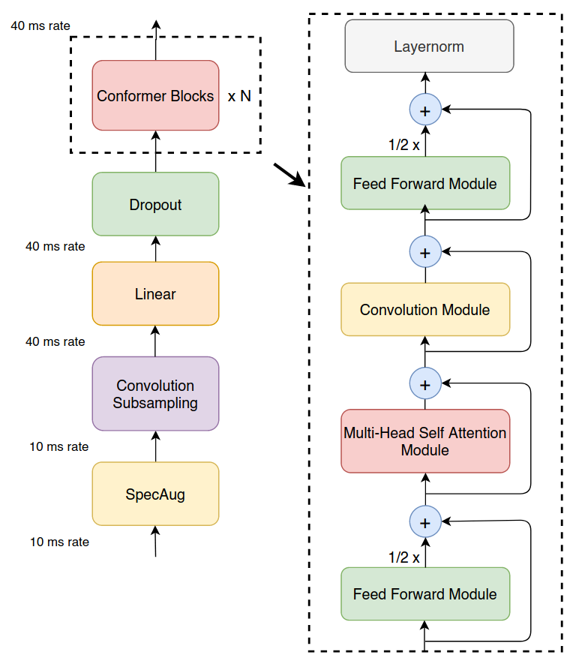
Conformer
In the literature, several variations of Transformers have been proposed.
A popular one used in ASR is the so-called Convolution-augmented Transformer (Conformer).
The conformer downsamples the input using a convolutional front-end (from 10ms to 40ms time resolution).
Moreover, it also interleaves attention and convolution modules in the main conformer block.
Feature Extraction
The conformer blocks consist of two feedforward modules, a multi-head self-attention module, and a convolutional module.

Slide 48
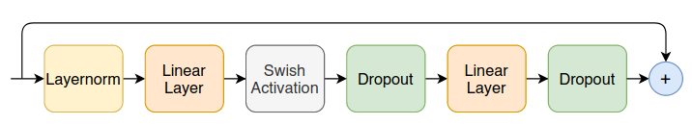
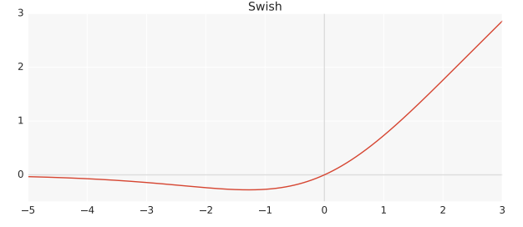
Conformer
Each feedforward module is composed of the following operations:
Feature Extraction

Slide 49
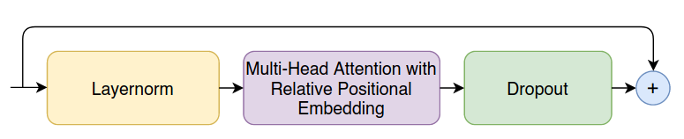
Conformer
The multi-head self-attention module performs the following operations:
The Conformer uses a special type of multi-head attention coupled with relative positional embeddings.
Feature Extraction
The positional embeddings inject relative distance information into the attention scores directly.

Slide 50
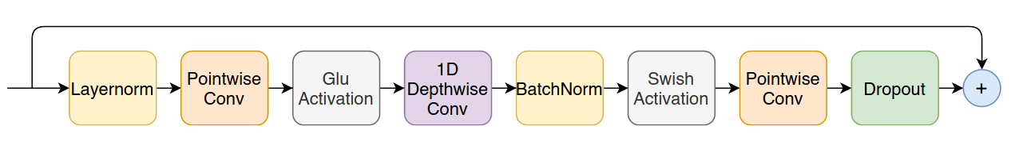
Conformer
The convolution module performs the following operations:
In Pointwise Convolution, every filter integrates over the channel axis only (not over the time axis).
We use a number of filters equal to the number of output channels.
Feature Extraction
Pointwise Conv
Input Channels
Output Channels
Time
Time

Slide 51
Conformer
The convolution module performs the following operations:
In Depthwise Convolution each filter integrates over the time axis only (not over the channel axis).
We use a different filter for each input channel
Feature Extraction
Depthwise Conv
Input Channels
Input Channels
Time
Time

Slide 52
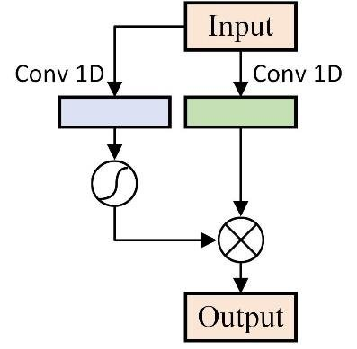
Conformer
The convolution module performs the following operations:
Gated Linear Units (GLU)
W, V, b, c
Learnable Parameters
Feature Extraction
GLU employs a gate mechanism, similar to LSTM's output gate, to control the information exposed in the output.
This can be thought of as a non-linear activation function.

Slide 53
Conformer
The convolution module performs the following operations:
Gated Linear Units (GLU)
W, V, b, c
Learnable Parameters
Feature Extraction
GLU employs a gate mechanism, similar to LSTM's output gate, to control the information exposed in the output.
This can be thought of as a non-linear activation function.

Slide 54
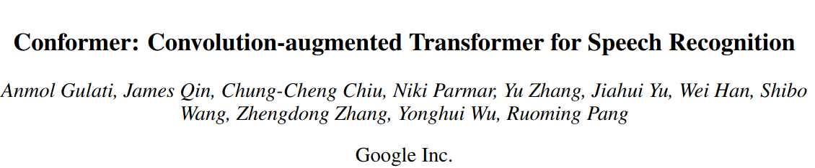
Conformer
Conformers turned out to work well for speech recognition.
Conformers typically have faster convergence than Transformers, but they don't always outperform them.
Proper hyperparameter tuning is crucial for achieving good performance
Paper
More info:

Slide 55
Self-Supervised Learning
A common approach used these days to improve the performance of an ASR is to use a self-supervised learning model as an encoder.
Speech
Encoder
Decoder
Output Tokens
Attention
Wav2vec2
Hubert
WavLM
Self-supervised models can improve performance, convergence speed, and reduce the need for labeled data.
The drawback is that the resulting models are very large, with numerous parameters and high memory demands.

Slide 56
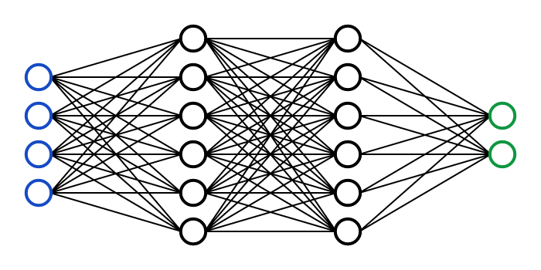
Self-Training
Another trick to improve the performance is self-training.
ASR Model
Supervised Dataset
The basic idea is to utilize a speech recognizer to transcribe a large unannotated speech dataset.
We then use the ASR transcriptions as labels.
Training
Large Unlabeled Dataset
ASR Transcriptions
Inference
The steps to follow are:
1- Train an ASR model with a supervised dataset.
2- Transcribe a large unannotated dataset.
ASR Transcriptions
3- Fine-tune the model using the ASR transcriptions as labels.
ASR Model
Fine-tuning

Slide 57
Multilingual ASR
Another way to improve the performance of speech recognition is via multi-task learning.
A recent trend consists to train speech recognizers in multiple languages.
Lang1
Speech
Encoder
Decoder
Lang2
…
Attention
Lang3
Linear classifier
Since many languages share similarities, such as similar phonemes, training in multiple languages simultaneously can often lead to improved performance for all languages.
There are different ways to build a multilingual model (sharing the encoder only, sharing the encoder and decoder with just a different final linear classifier, …)

Slide 58
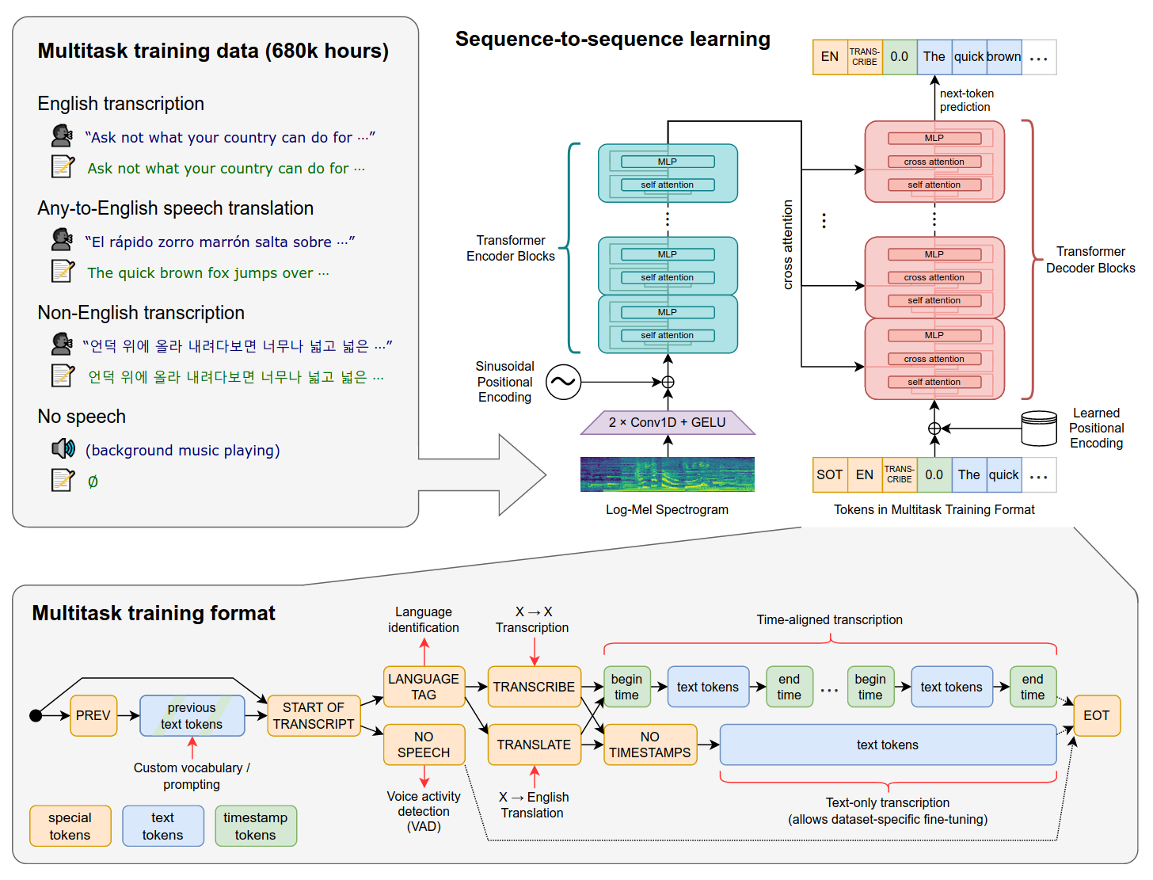

Whisper
A popular model recently released by OpenAI is Whisper.
It is more than just a multilingual ASR as it can also do other tasks such as speech translation.
It is a transformer-based encoder-decoder architecture, trained with 680k hours of weakly annotated data.
77 years of speech!

Slide 59
Whisper
A popular model recently released by OpenAI is Whisper.
To obtain such a large weakly annotated speech dataset, they massively crawl the web.
Once they have collected a large transcribed corpus, they develop simpler heuristics to filter the data.

Slide 60
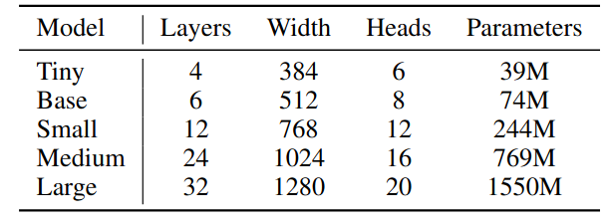
Whisper
A popular model recently released by OpenAI is Whisper.
Whisper introduces a format to manage multiple tasks with a single model.
In particular, they prepend some special tokens (e.g., transcribe vs translate) to specify if the system needs to do ASR or speech translation.

Slide 61
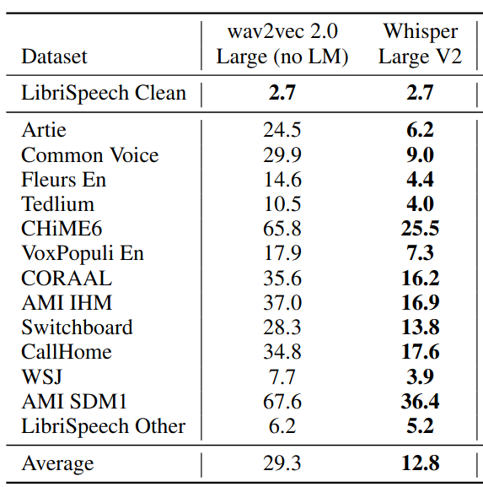
Whisper
Whispers is a state-of-the-art speech recognizer.
OpenAI released the pretrained model (already available in SpeechBrain).
However, they did not release the training recipe and the data.

Slide 62


Encoder-Decoder ASR
Encoder-Decoder models have the following advantages:
Excellent Performance
Can take advantage of self-supervised models, multiple languages, and multiple tasks.
Flexibility
Computational-demanding
Memory demanding, Long training/inference times
Needs for large a amount of data (when not using self-supervised models)
In certain applications, it is desirable for an ASR system to produce output in real-time as speech is being spoken, instead of waiting until the end of a speech segment to generate output.
Non-streamable

Slide 63


Extra Lecture
In the extra-lecture, we will see:
Transducers
CTC
Beamsearch
There is a lab assignment for the extra-lecture as well.
The extra lecture might be object of questions in the final exam.

Slide 64


Lab Session
During the weekly lab session, we will do:
Speech Recognition from Scratch
Speech Recognition - Part 1
Deadline: March, 27 11.59 pm
Speech Recognition - Part 2
Deadline: March, 31 11.59 pm

Slide 65
References
[1] Lee D. Erman, "Overview of the hearsay speech understanding research", Paper
[2] L. R. Rabiner, "A tutorial on hidden Markov models and selected applications in speech recognition," in Proceedings of the IEEE, vol. 77, no. 2, pp. 257-286, Feb. 1989, paper.
[3] M. Ravanelli, "Deep Learning for Distant Speech Recognition", PhD Thesis, Thesis.
[4] Daniel S. Park, William Chan, Yu Zhang, Chung-Cheng Chiu, Barret Zoph, Ekin D. Cubuk, Quoc V. Le, "SpecAugment: A Simple Data Augmentation Method for Automatic Speech Recognition", Paper.
[5] Taku Kudo, John Richardson, "SentencePiece: A simple and language independent subword tokenizer and detokenizer for Neural Text Processing" Paper.
[6] Jan Chorowski, Dzmitry Bahdanau, Dmitriy Serdyuk, Kyunghyun Cho, Yoshua Bengio, "Attention-Based Models for Speech Recognition", Paper.
[7] Anmol Gulati, James Qin, Chung-Cheng Chiu, Niki Parmar, Yu Zhang, Jiahui Yu, Wei Han, Shibo Wang, Zhengdong Zhang, Yonghui Wu, Ruoming Pang, "Conformer: Convolution-augmented Transformer for Speech Recognition", Paper.
[8] Alec Radford, Jong Wook Kim, Tao Xu, Greg Brockman, Christine McLeavey, Ilya Sutskever, "Robust Speech Recognition via Large-Scale Weak Supervision", Paper.
[9] A. Graves, S. Fernandez, F. Gomez, and J. Schmidhuber, "Connectionist Temporal Classification: Labelling Unsegmented Sequence Data with Recurrent Neural Nets", Paper.

